Slide 1
What's serverless?
• Serverless is a new paradigm in which the developers don't have to
manage servers anymore...
• They just deploy code
• They just deploy... functions !
• Initially... Serverless == FaaS (Function as a Service)
• Serverless was pioneered by AWS Lambda but now also includes
anything that's managed: "databases, messaging, storage, etc."
• Serverless does not mean there are no servers...
it means you just don't manage / provision / see them

Slide 2
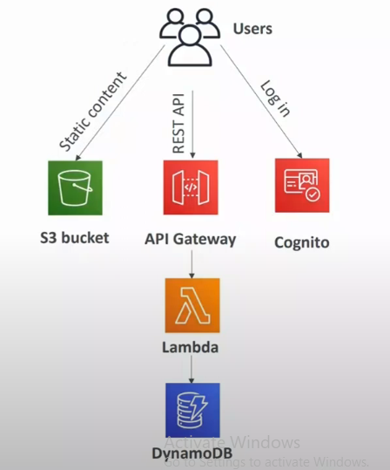
Serverless in AWS
• AWS Lambda
• DynamoDB
• AWS Cognito
• AWS API Gateway
• Amazon S3
• AWS SNS & SQS
• AWS Kinesis Data Firehose
• Aurora Serverless
• Step Functions
• Fargate

Slide 3
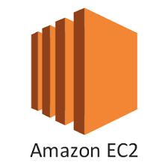

AWS Lambda — Why is it Popular?
• Virtual Servers in the Cloud
• Limited by RAM and CPU
• Continuously running
• Scaling means intervention to add / remove servers
-------------------------------------------------------------------------------------
• Virtual functions — no servers to manage!
• Limited by time - short executions
• Run on-demand
• Scaling is automated!

Slide 4

Benefits of AWS Lambda
• Easy Pricing:
• Pay per request and compute time
• Free tier of 1,000,000 AWS Lambda requests and 400,000 GBs of compute time
• Integrated with the whole AWS suite of services
• Integrated with many programming languages
• Easy monitoring through AWS CloudWatch
• Easy to get more resources per functions (up to IOGB of RAM!)
• Increasing RAM will also improve CPU and network!

Slide 5
AWS Lambda language support
• Node.js (JavaScript)
• Python
• Java (Java 8 compatible)
• (.NET core)
. Golang
• C# / Powershell
• Ruby
• Custom Runtime API (community supported, example Rust)

Slide 6
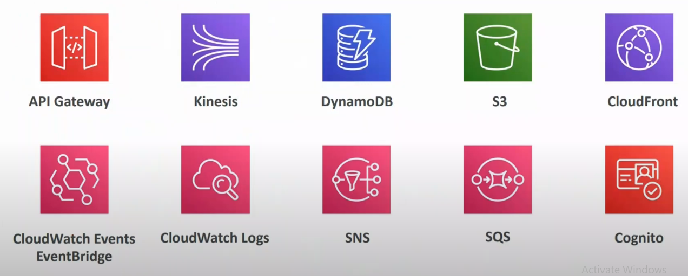
AWS Lambda Integrations Important ones

Slide 7
AWS Lambda Pricing : example
• Pay per calls:
• First 1 requests are free
• $0.20 per 1 million requests thereafter ($0.0000002 per request)
• Pay per duration: (in increment of 1 ms)
• 400,000 GB-seconds of compute time per month for FREE
• == 400,000 seconds if function is IGB RAM
• 3,200,000 seconds if function is 128 MB RAM
• After that $1.00 for 600,000 GB-seconds
• It is usually very cheap to run AWS Lambda so it's very popular
• You can find overall ricin information here:
https://aws.amazon.com/lambda/pricing/

Slide 8
AWS Lambda Limits to Know – per region
• Execution:
• Memory allocation: 128 MB — IOGB (1 MB increments)
• Maximum execution time: 900 seconds (15 minutes)
• Environment variables (4 KB)
• Disk capacity in the "function container" (in /tmp): 512 MB to IOGB
• Concurrency executions: 1000 (can be increased)
• Deployment:
• Lambda function deployment size (compressed . zip): 50 MB
• Size of uncompressed deployment (code + dependencies): 250 MB
• Can use the /tmp directory to load other files at startup
• Size of environment variables: 4 KB

Slide 9
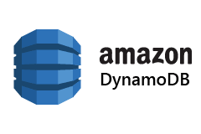
Amazon DynamoDB
• Fully managed, highly available with replication across multiple AZS
• NoSQL database - not a relational database - with transaction
support
• Scales to massive workloads, distributed database
• Millions of requests per seconds, trillions of row, IOOs of TB of storage
• Fast and consistent in performance (single-digit millisecond)
• Integrated with IAM for security, authorization and administration
• Low cost and auto-scaling capabilities
• No maintenance or patching, always available
• Standard & Infrequent Access (IA) Table Class

Slide 10

DynamoDB - Basics
• DynamoDB is made of Tables
• Each table has a Primary Key (must be decided at creation time)
• Each table can have an infinite number of items (z rows)
• Each item has attributes (can be added over time — can be null)
• Maximum size of an item is 400KB
• Data types supported are:
• Scalar Types — String, Number, Binary, Boolean, Null
• Document Types — List, Map
• Set Types — String Set, Number Set, Binary Set
• Therefore, in DynamoDB you can rapidly evolve schemas

Slide 11
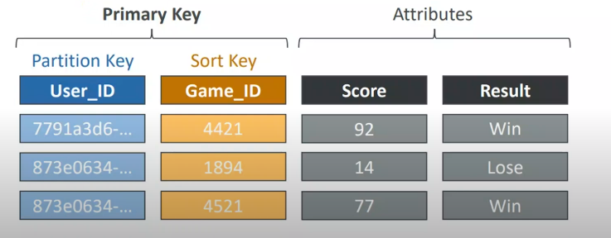
DynamoDB - Table example

Slide 12
DynamoDB — Read/Write Capacity Modes
• Control how you manage your table's capacity (read/write throughput)
• Provisioned Mode (default)
• You specify the number of reads/writes per second
• You need to plan capacity beforehand
• Pay for provisioned Read Capacity Units (RCU) & Write Capacity Units (WCU)
• Possibility to add auto-scaling mode for RCU & WCU
• On-Demand Mode
• Read/writes automatically scale up/down with your workloads
• No capacity planning needed
• Pay for what you use, more expensive ($$$)
• Great for unpredictable workloads, steep sudden spikes

